Slide 1


Slide 2
An IoT Aware Smart Infant Incubator
By
Kaushik Padmanabhan

Slide 3
CONCEPT:
The smart infant incubator measure the values of,
Oxygen
Humidity
Temperature
These values are provided to the doctor and physician assistants so that if there occurs a problem in over or less production of above mentioned things in incubator, then their values can be easily controlled from remote location.

Slide 4
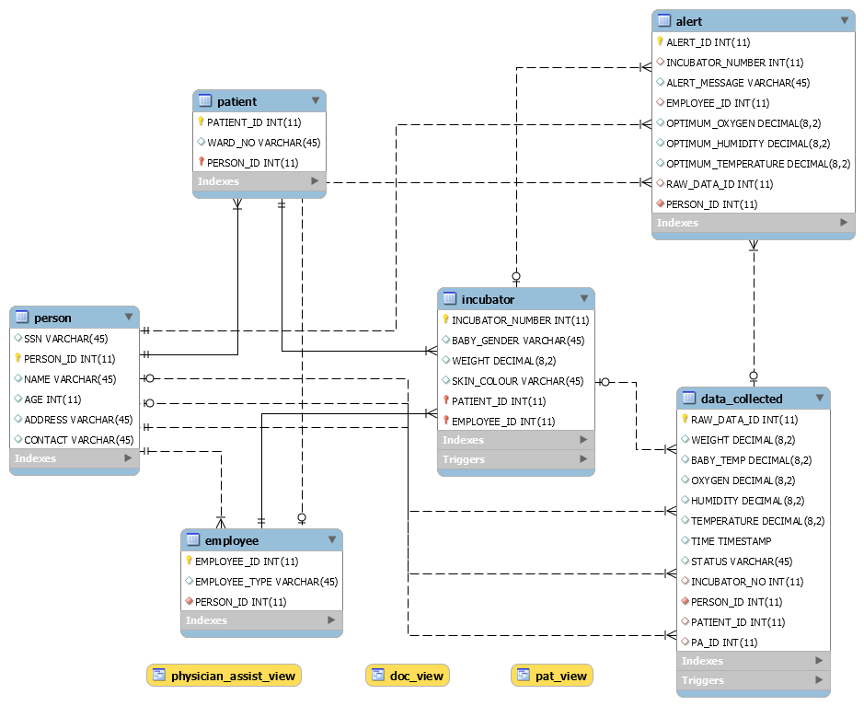
ER DIAGRAM:

Slide 5
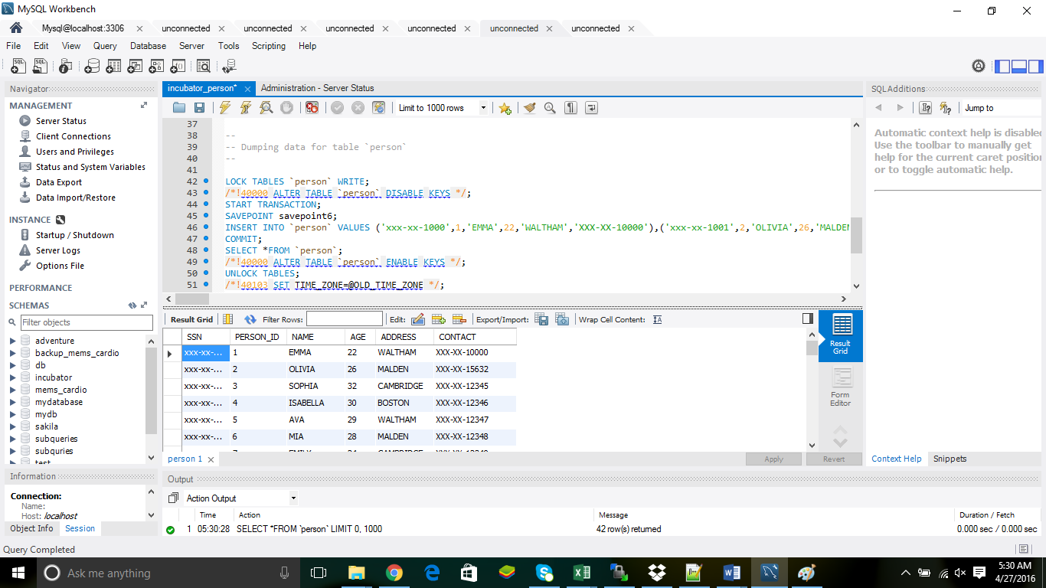
TABLES [PERSON]:

Slide 6
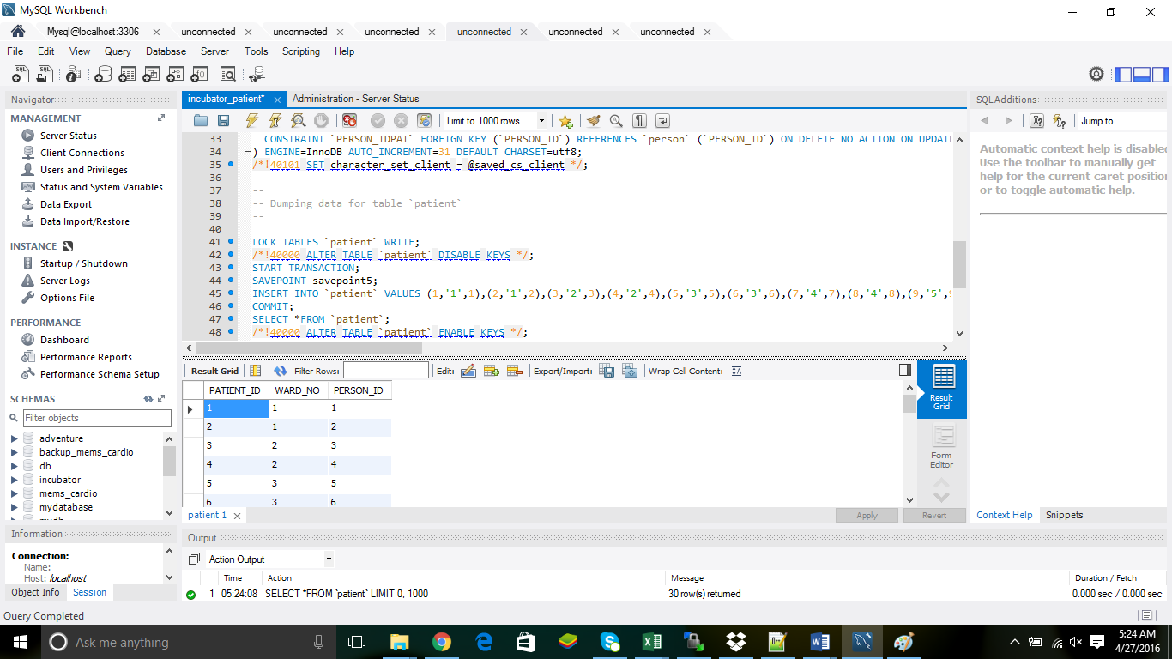
TABLES [PATIENT]:

Slide 7
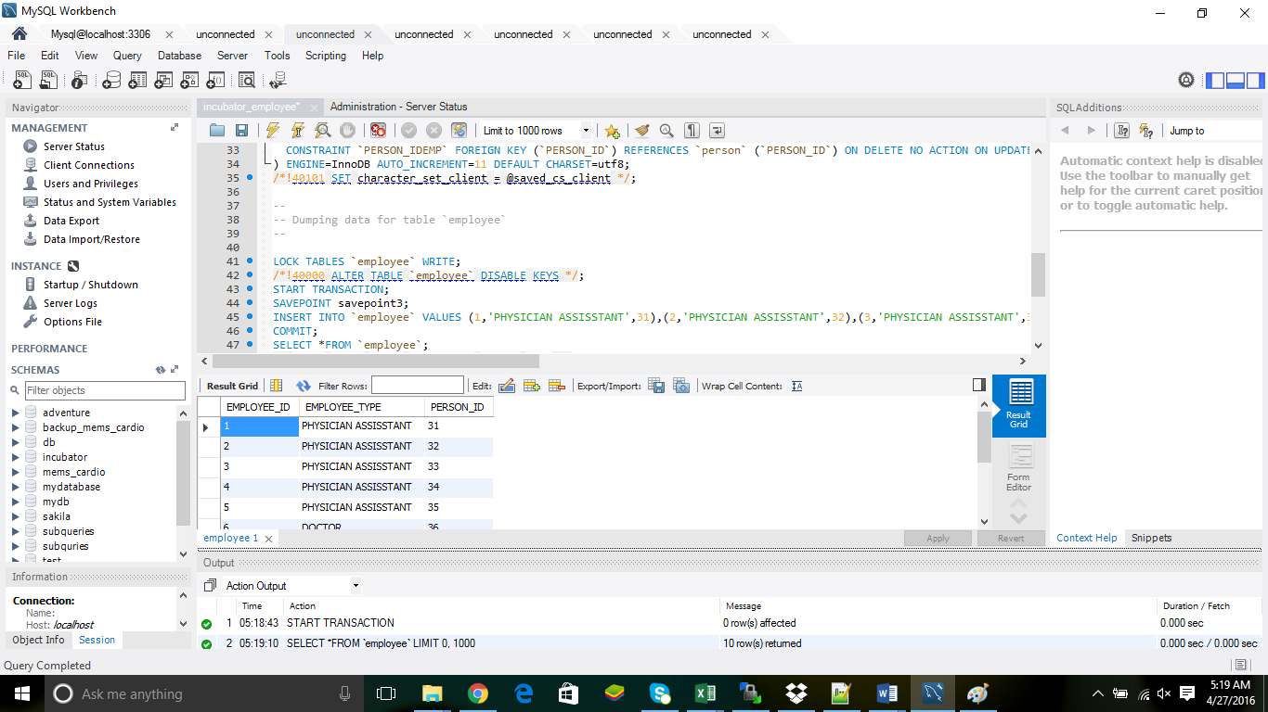
TABLES [EMPLOYEE]:

Slide 8
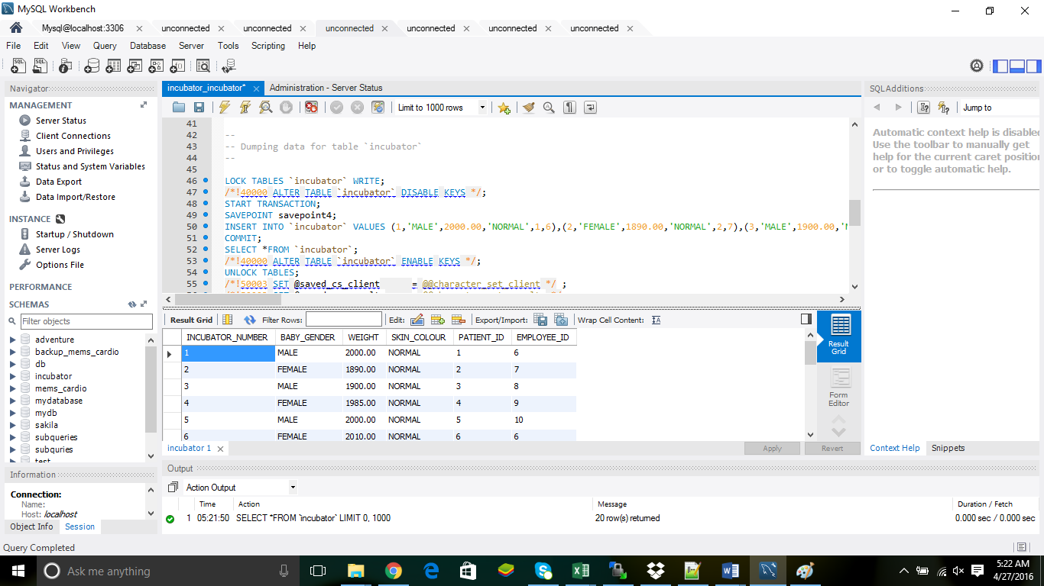
TABLES [INCUBATOR]:

Slide 9
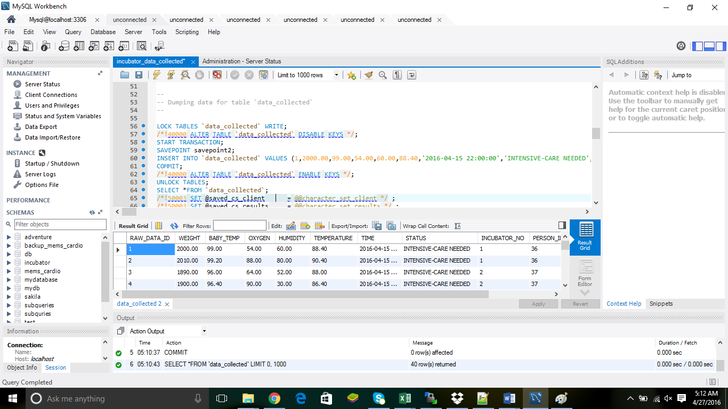
TABLES [DATA_COLL]:

Slide 10
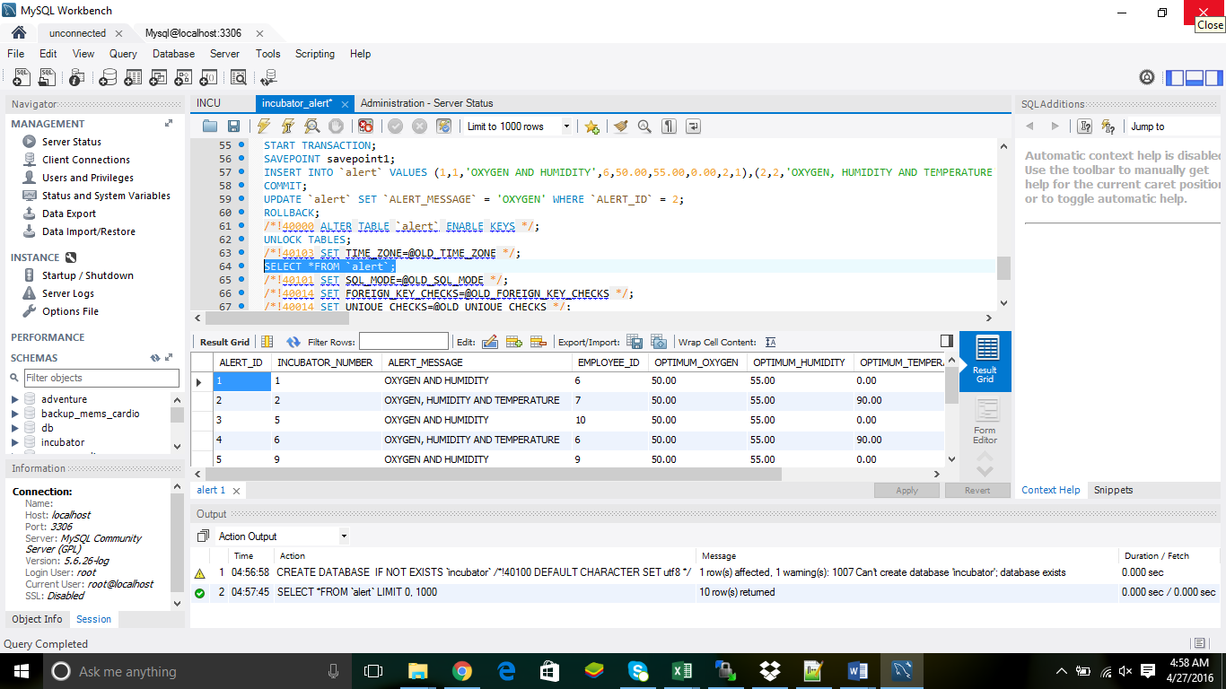
TABLES [ALERT]:

Slide 11
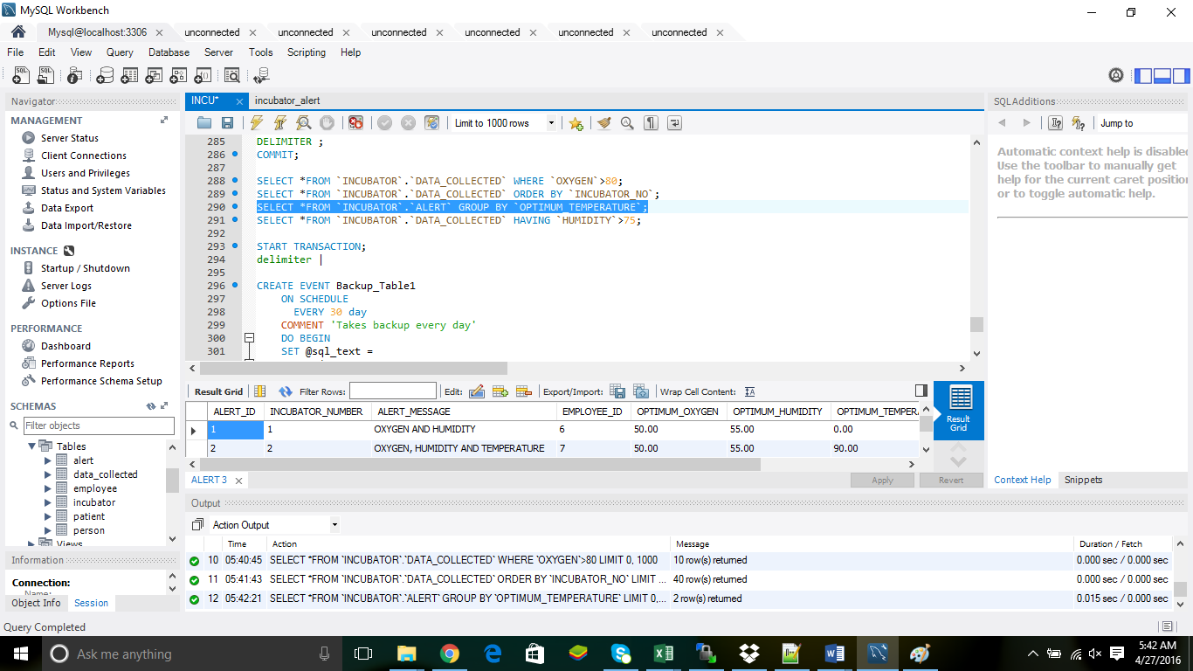
CLAUSES [GROUP BY]:

Slide 12
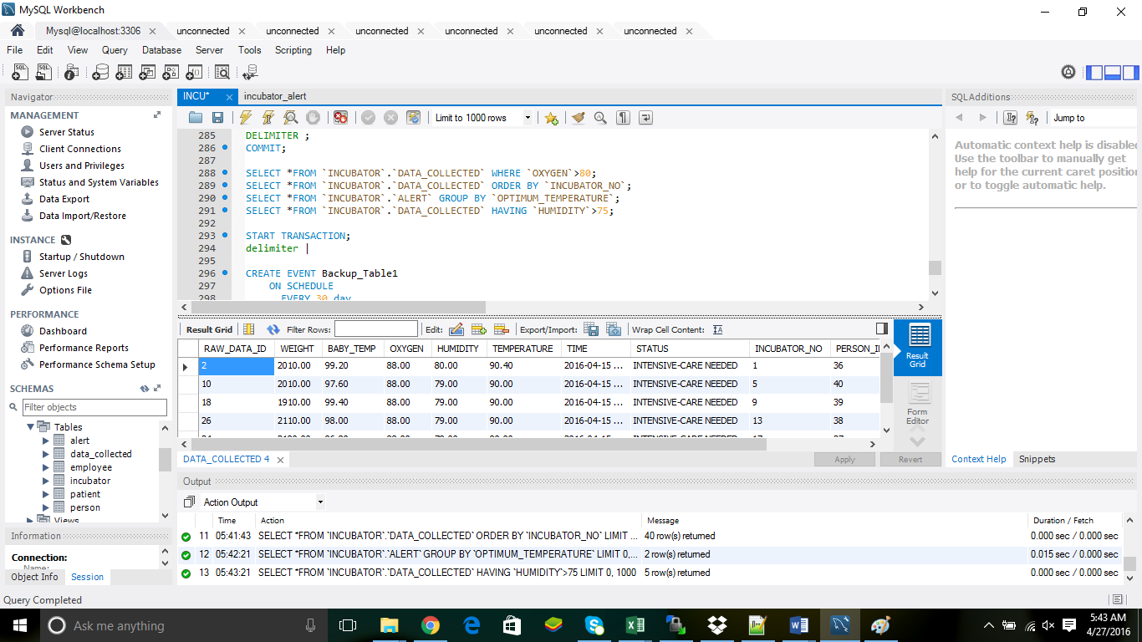
CLAUSES [HAVING]:

Slide 13
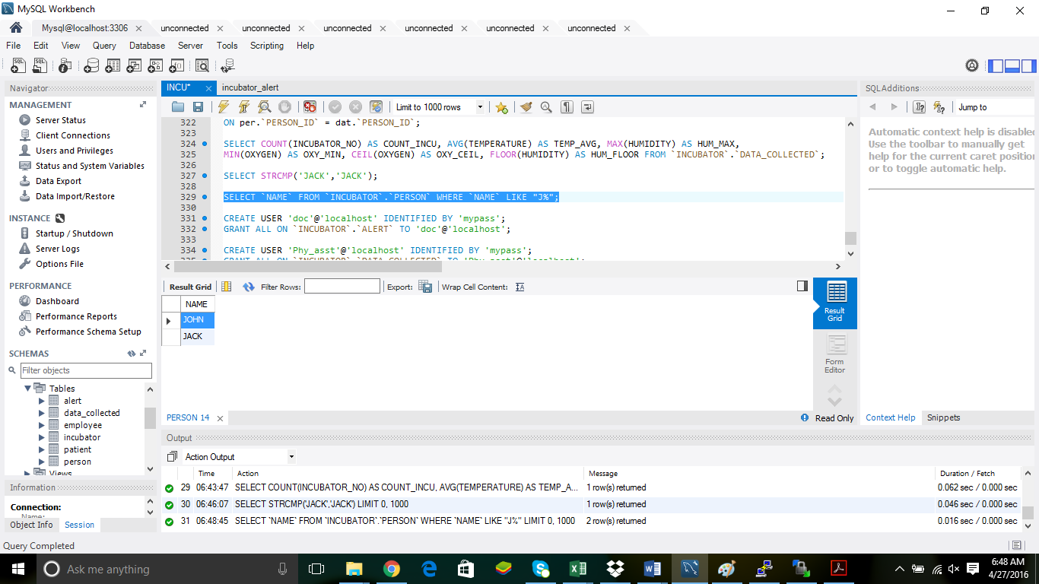
CLAUSES [LIKE]:

Slide 14
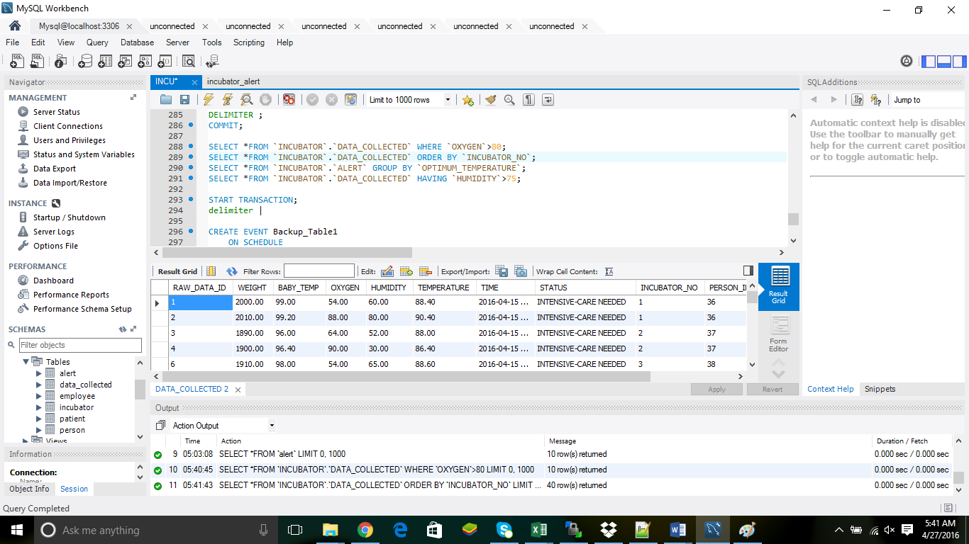
CLAUSES [ORDER BY]:

Slide 15
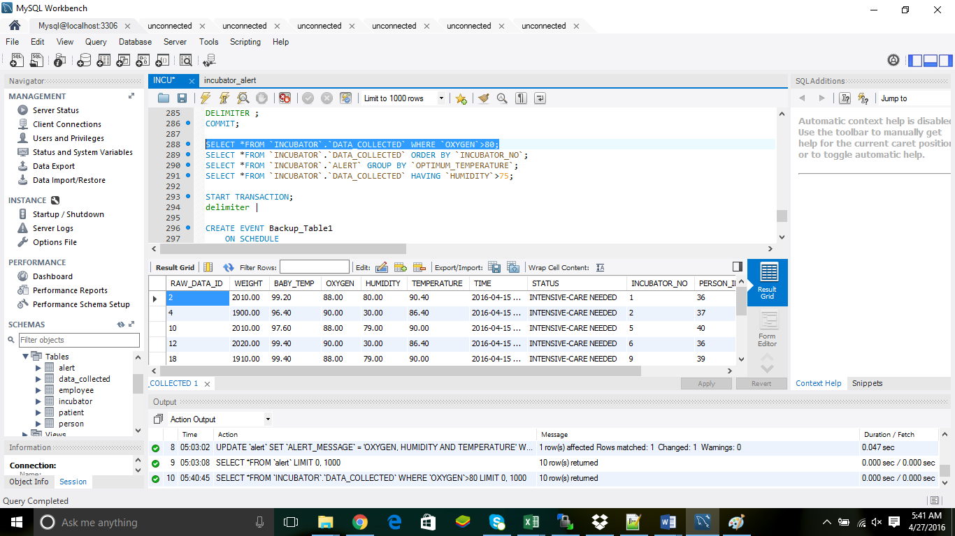
CLAUSES [WHERE]:

Slide 16
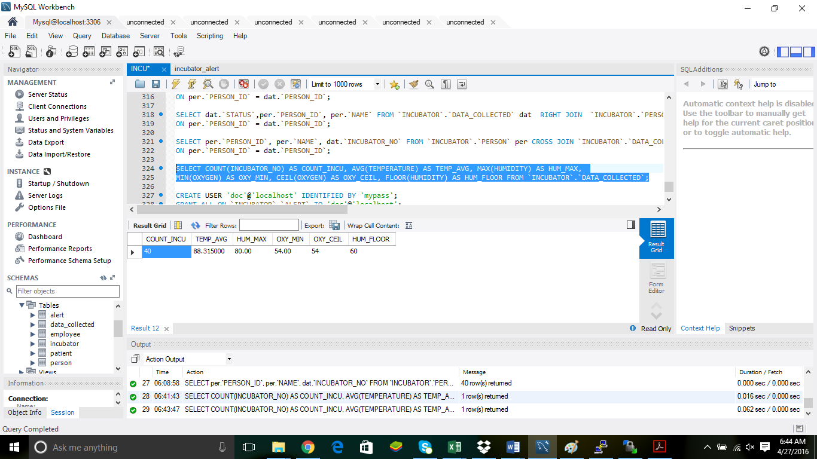
FUNCTIONS [ARITHMETIC]:

Slide 17
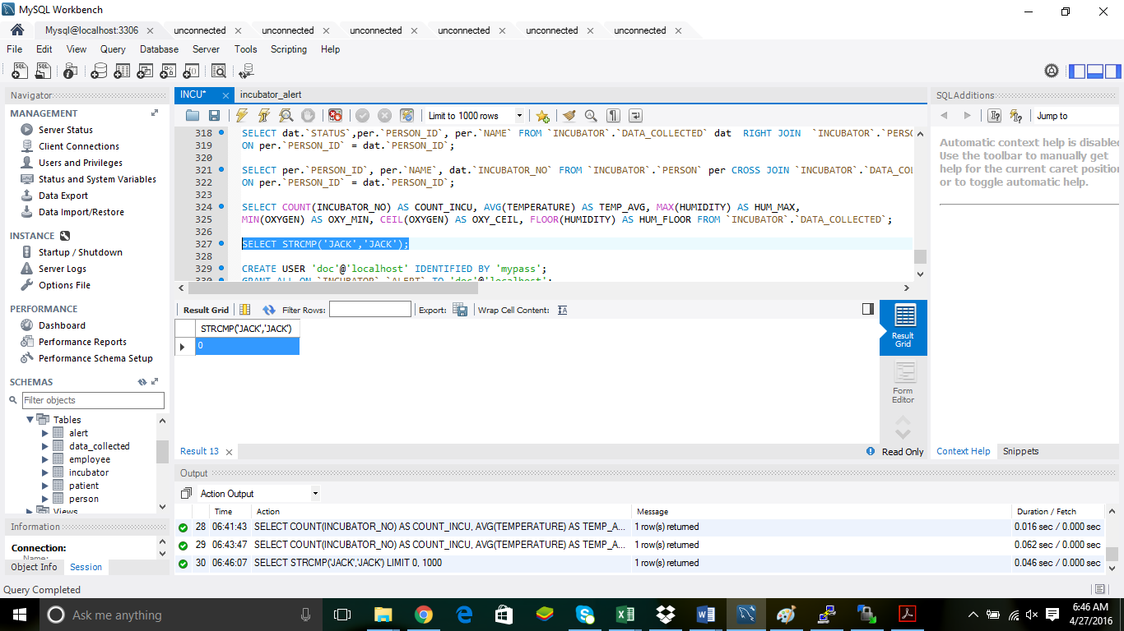
FUNCTIONS [STRING]:

Slide 18
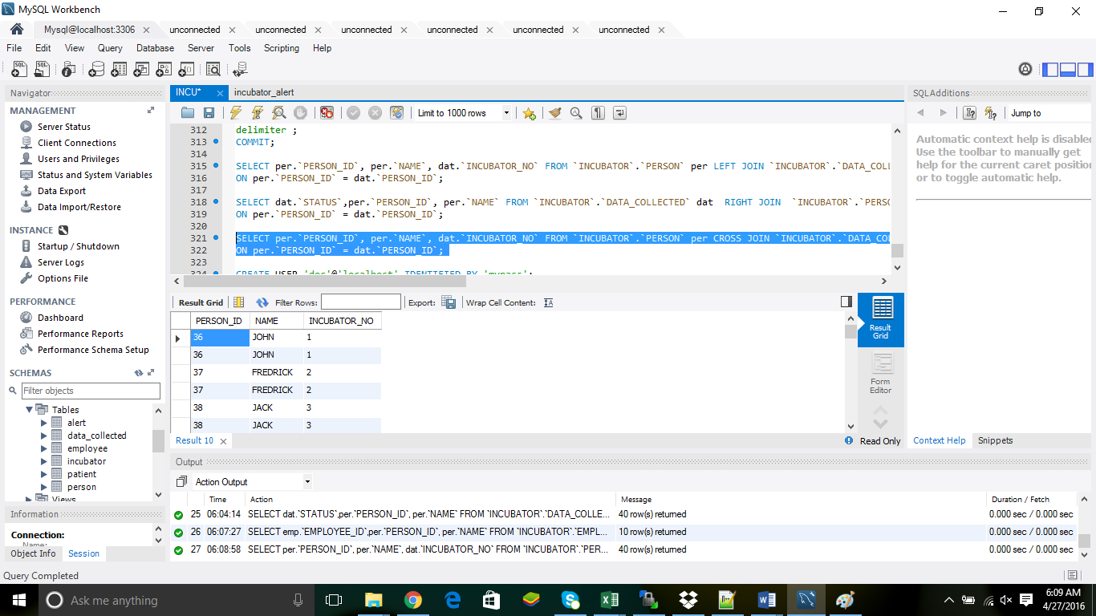
JOINS [CROSS]:

Slide 19
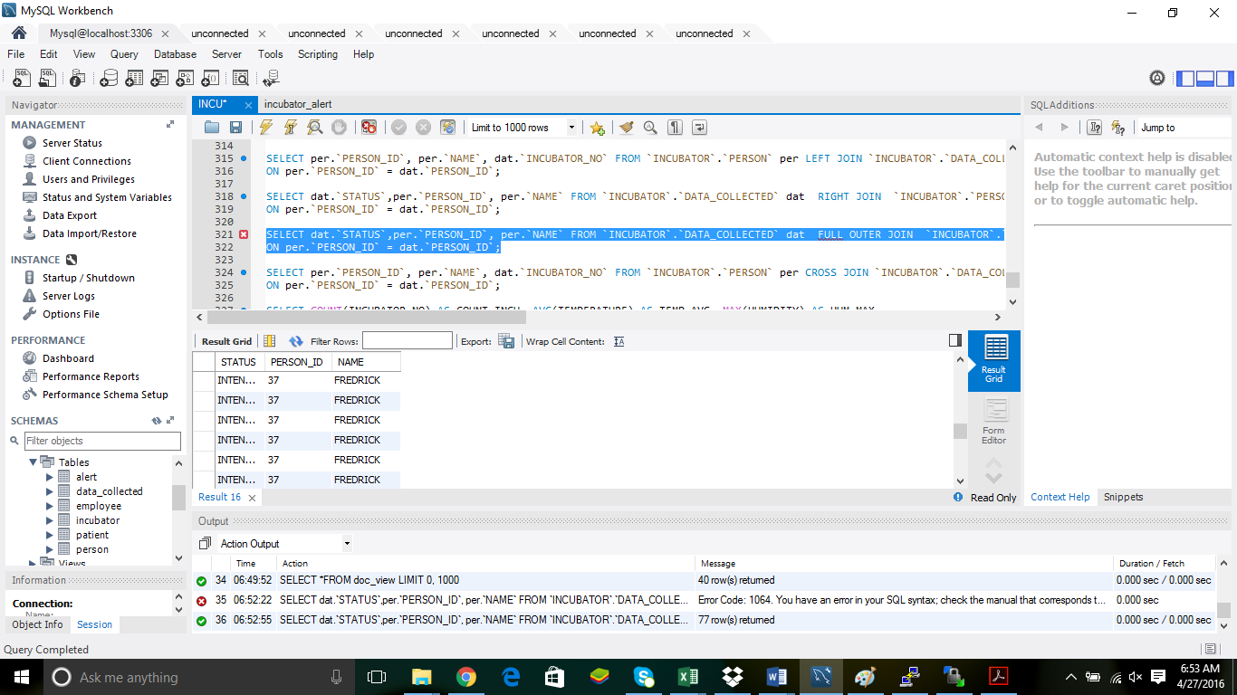
JOINS [FULL OUTER]:

Slide 20
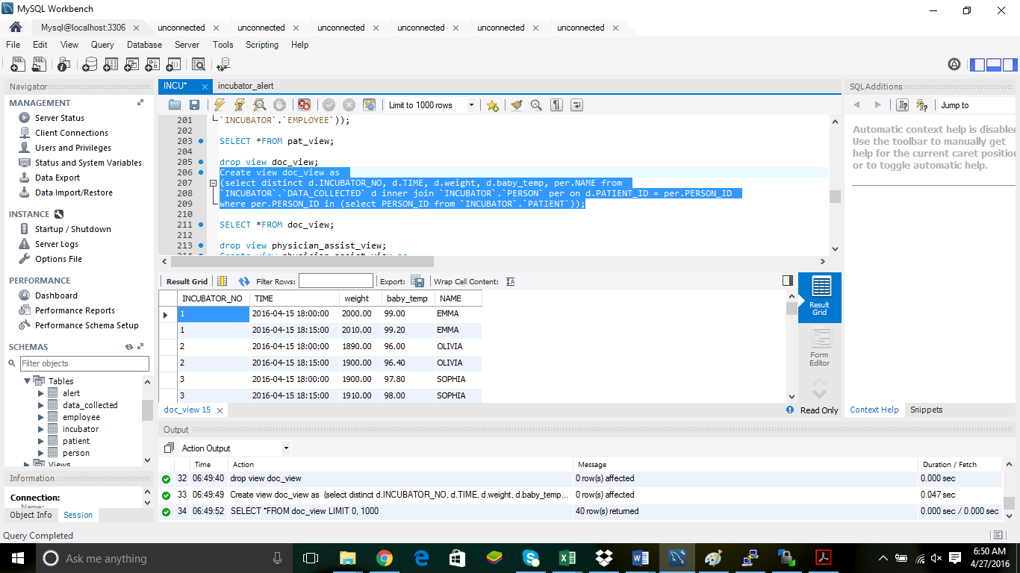
JOINS [INNER]:

Slide 21
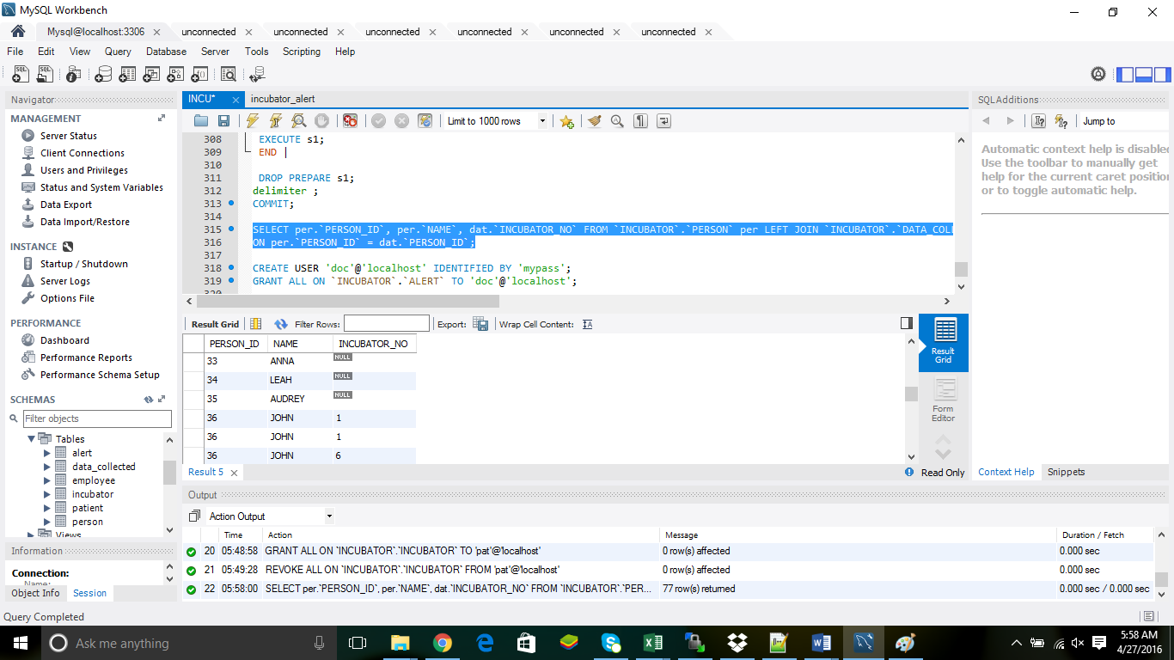
JOINS [LEFT]:

Slide 22
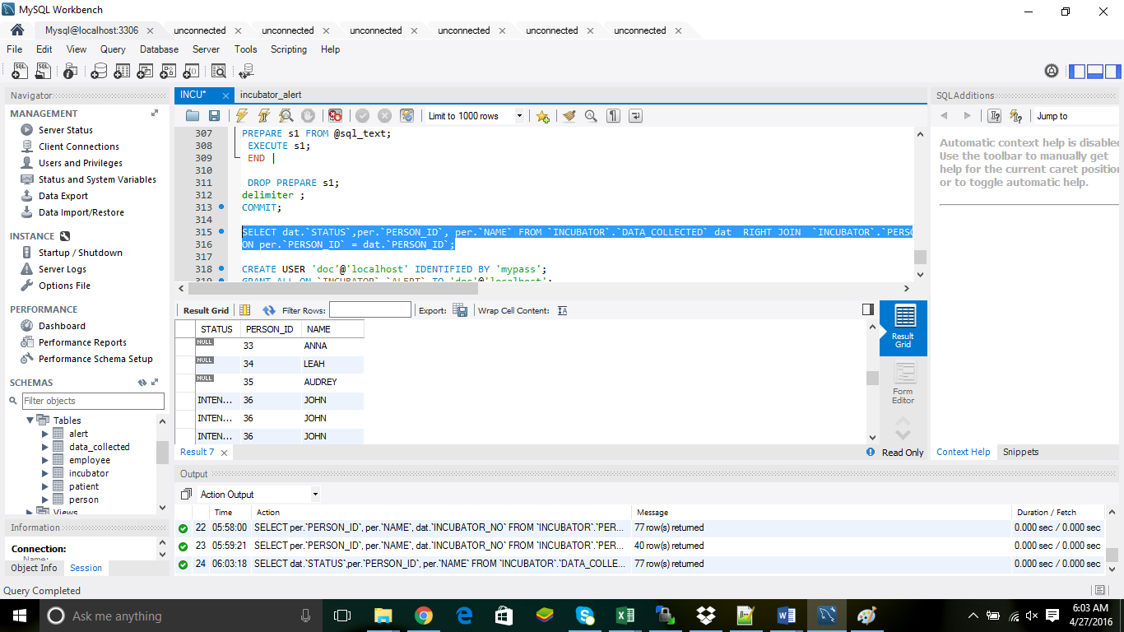
JOINS [RIGHT]:

Slide 23
SUB-QUERIES:

Slide 24
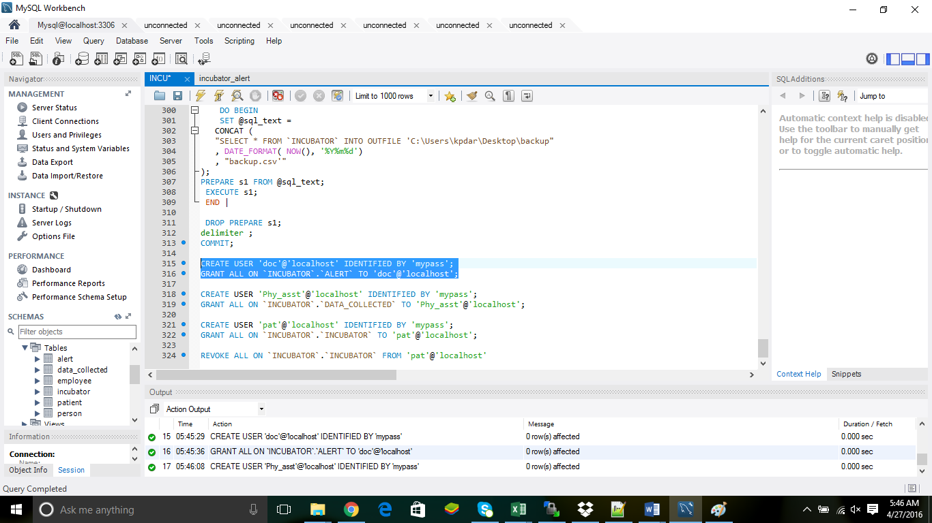
GRANT & REVOKE [DOC]:

Slide 25
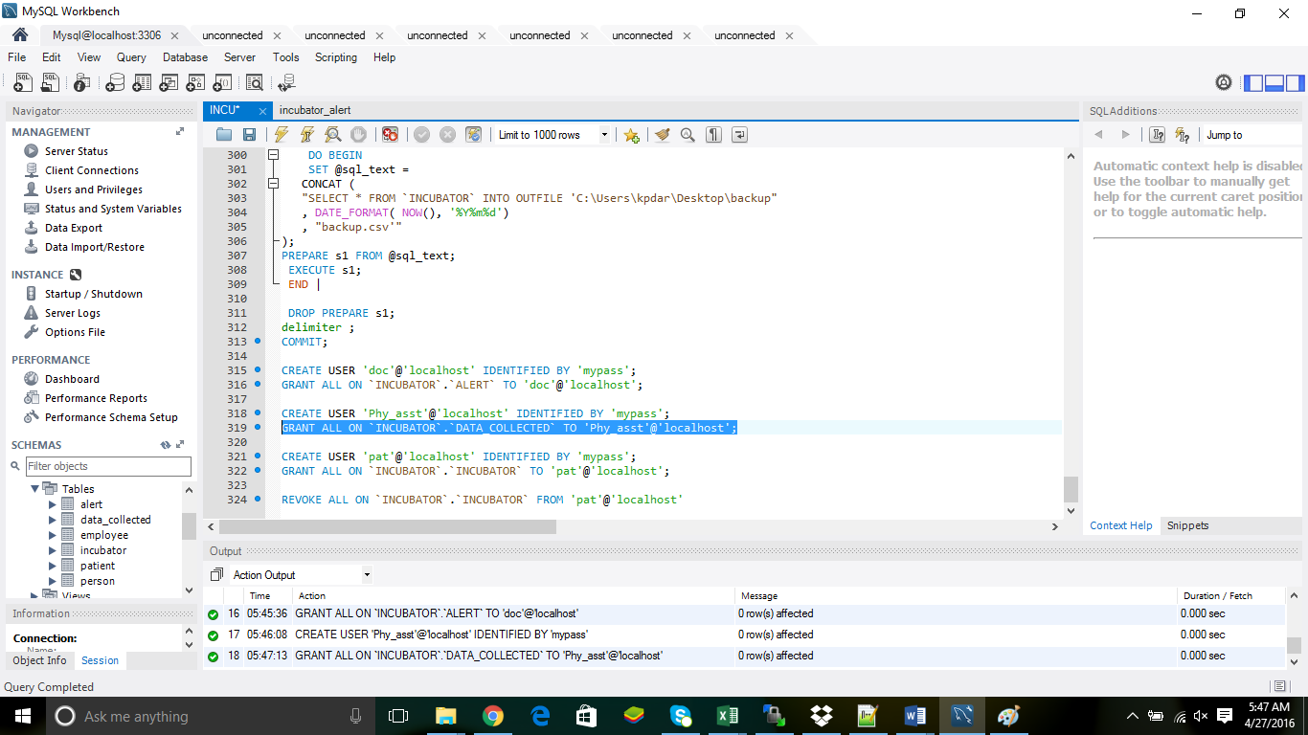
GRANT & REVOKE [PHYSICIAN ASSISTANT]:

Slide 26
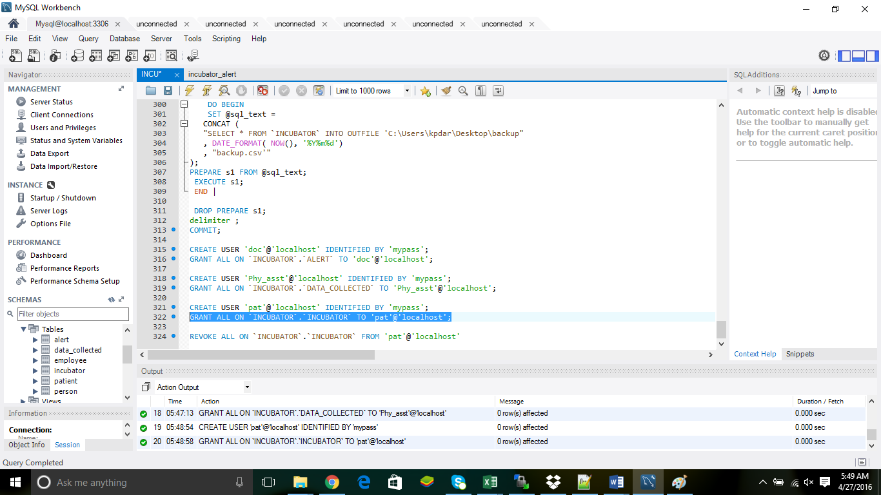
GRANT & REVOKE [PATIENT]:

Slide 27
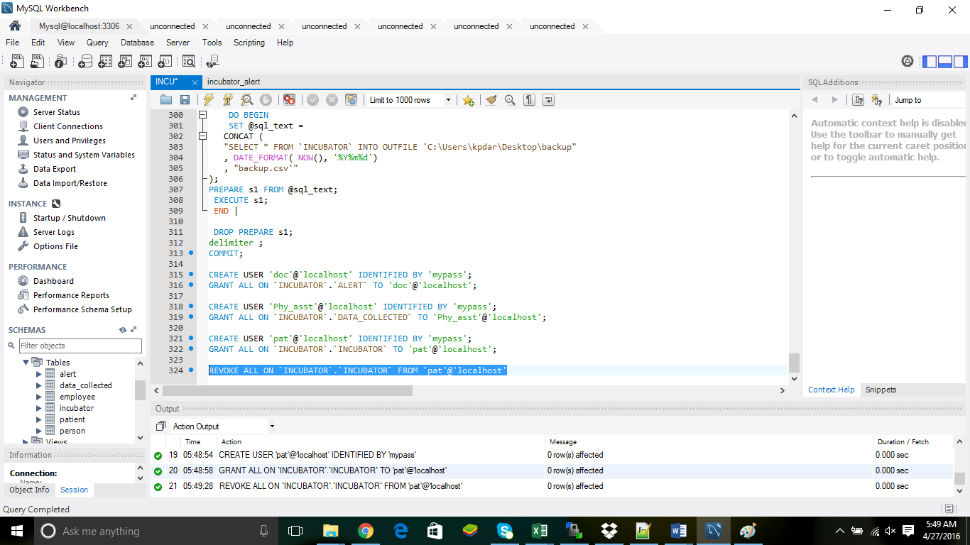
GRANT & REVOKE [PATIENT REVOKE]:

Slide 28
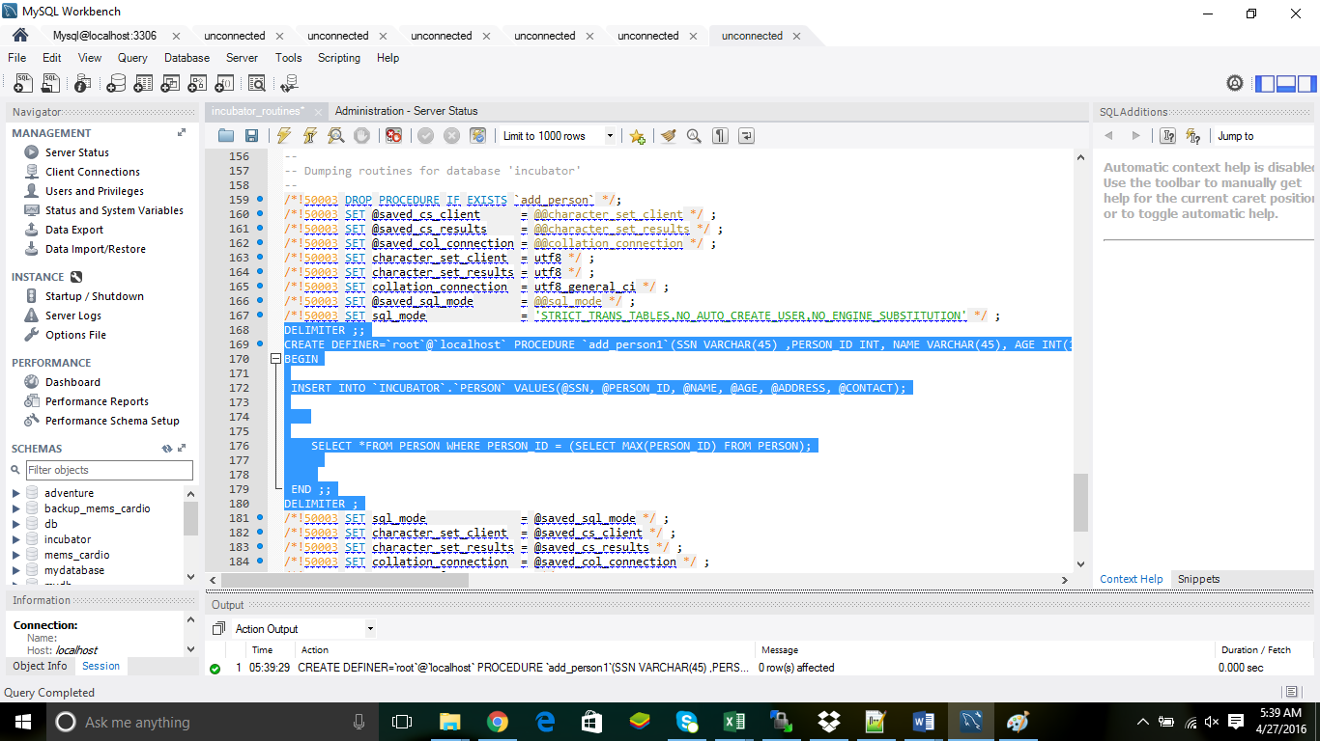
STORED PROCEDURE:

Slide 29
TRANSACTION [START TRANSACTION]:

Slide 30
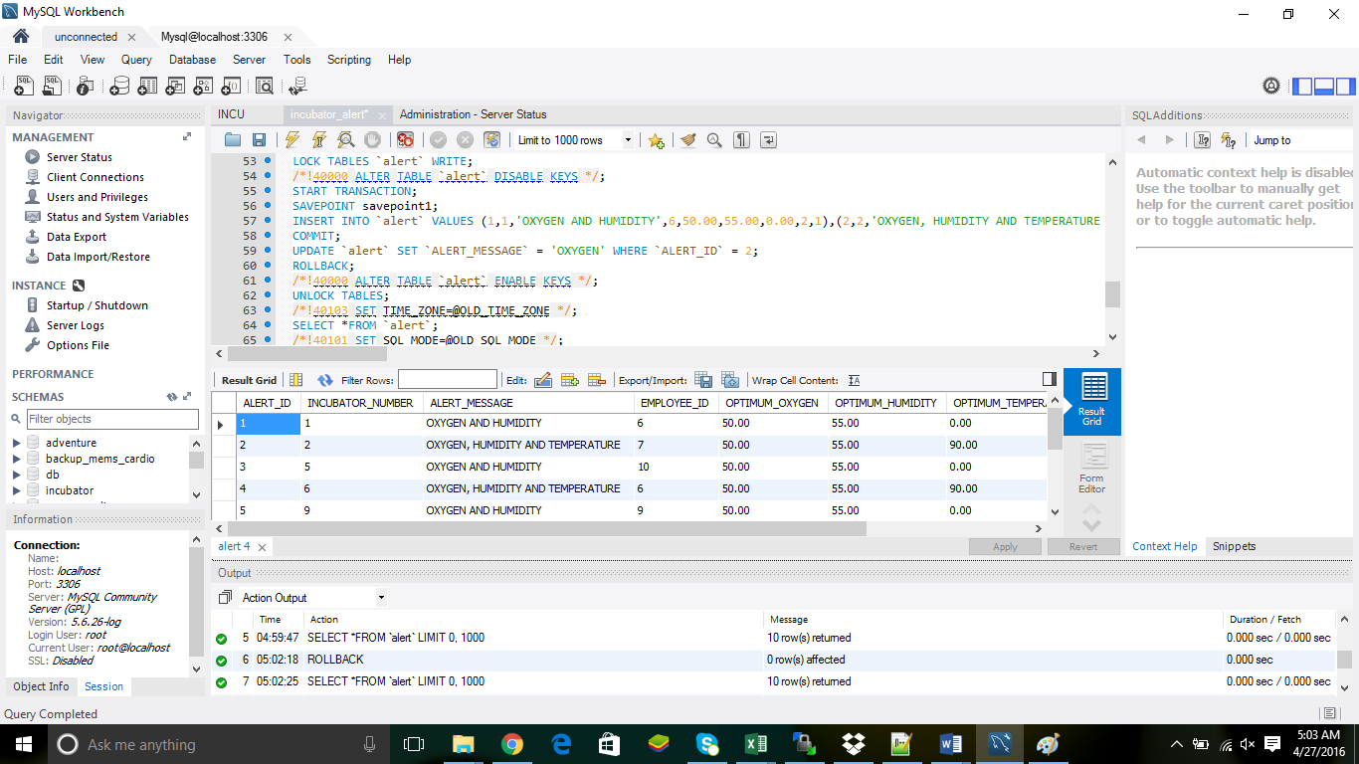
TRANSACTION [ALERT ROLLBACK]:

Slide 31
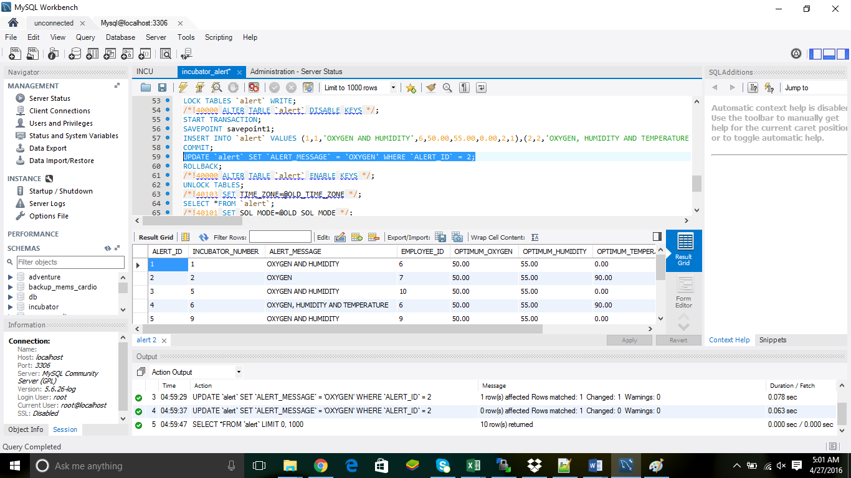
TRANSACTION [ALERT UPDATE]:

Slide 32
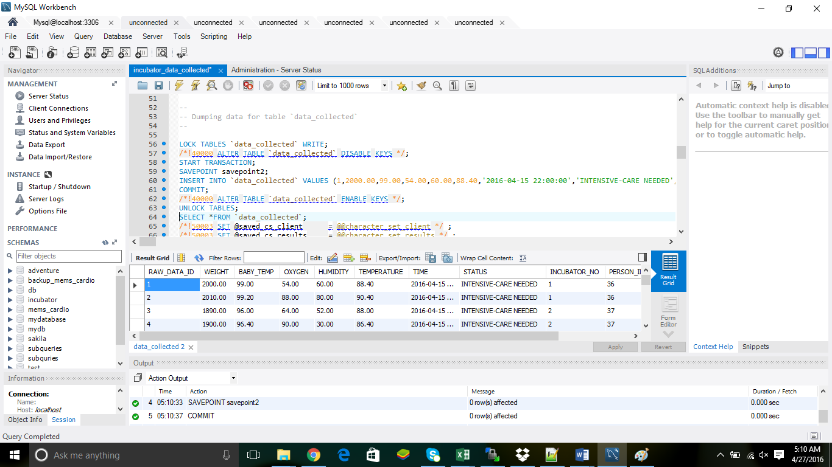
TRANSACTION [COMMIT AND SAVEPOINT]:

Slide 33
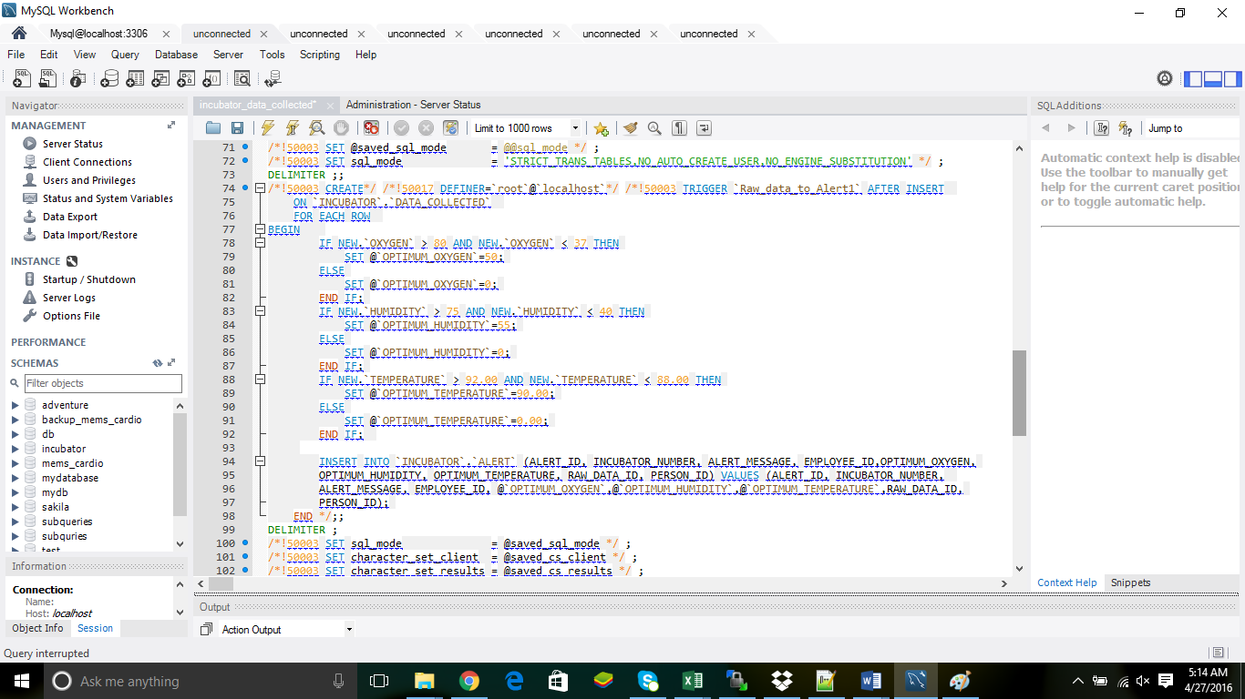
TRIGGER [INSERT]:

Slide 34
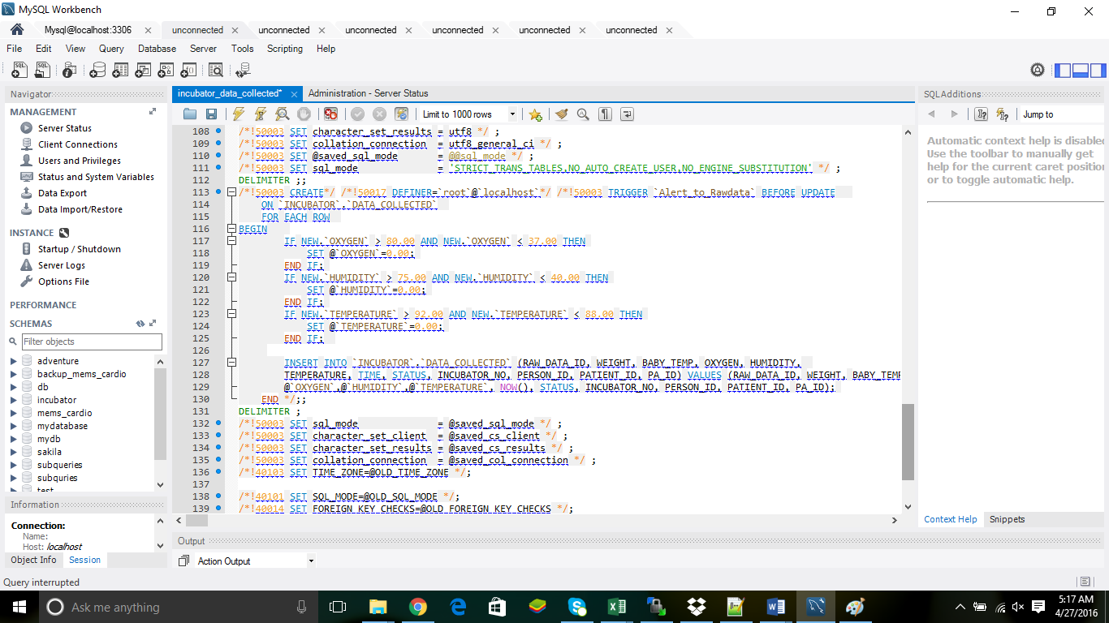
TRIGGER [UPDATE]:

Slide 35
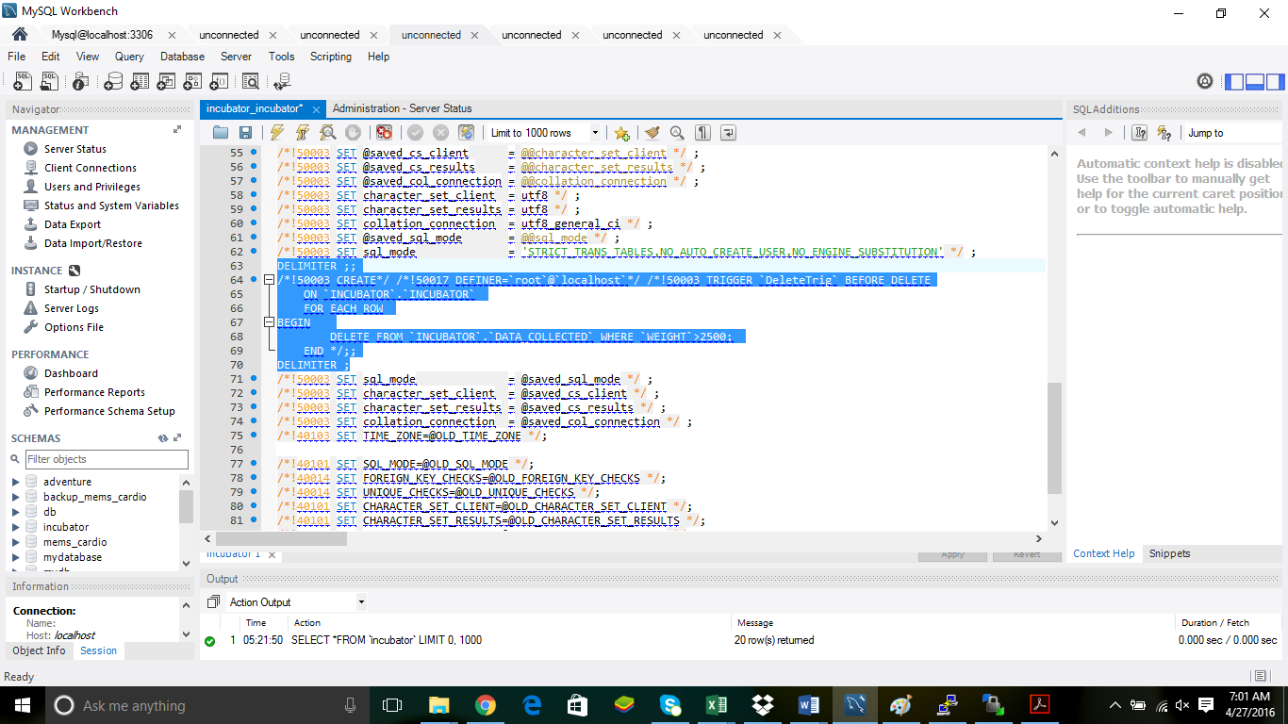
TRIGGER [DELETE]:

Slide 36
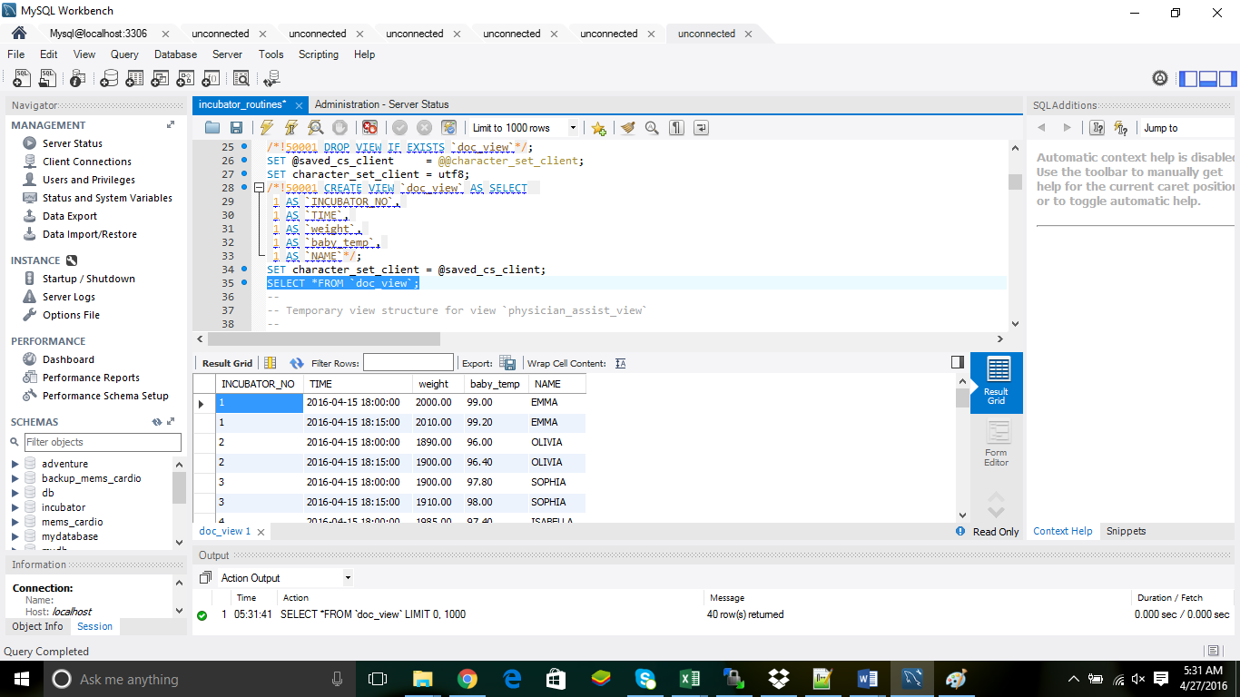
VIEWS [DOC]:

Slide 37
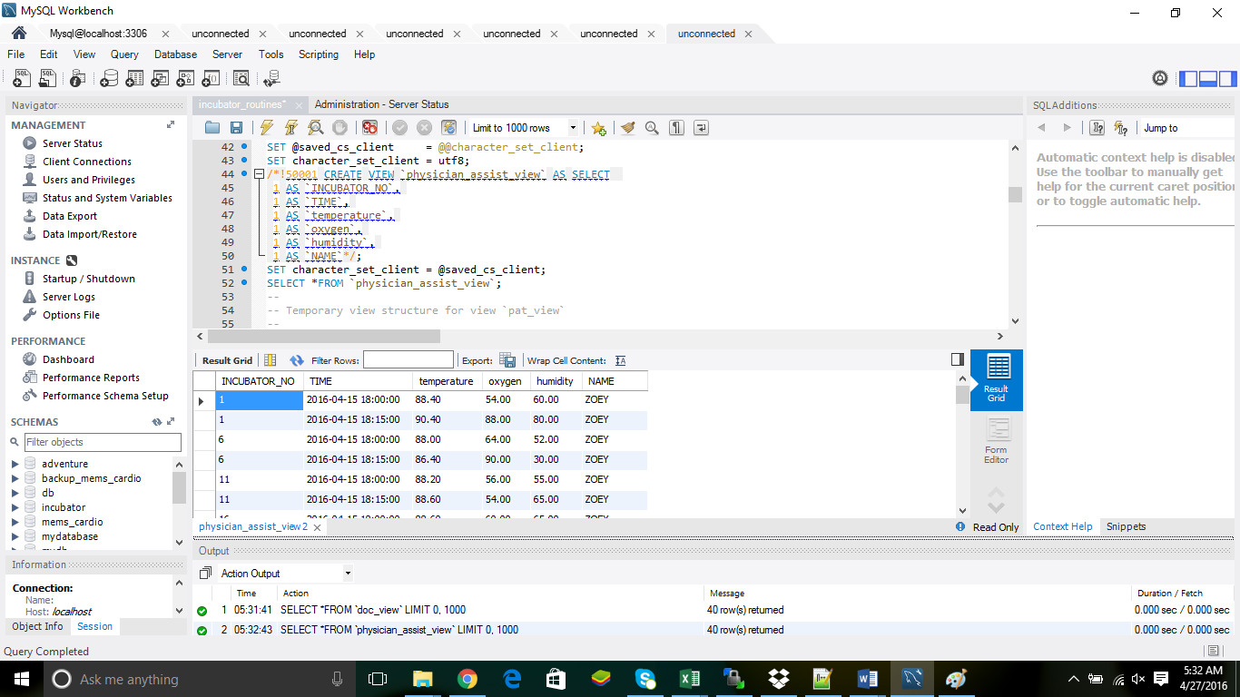
VIEWS [PHYSICIAN ASSISTANT]:

Slide 38
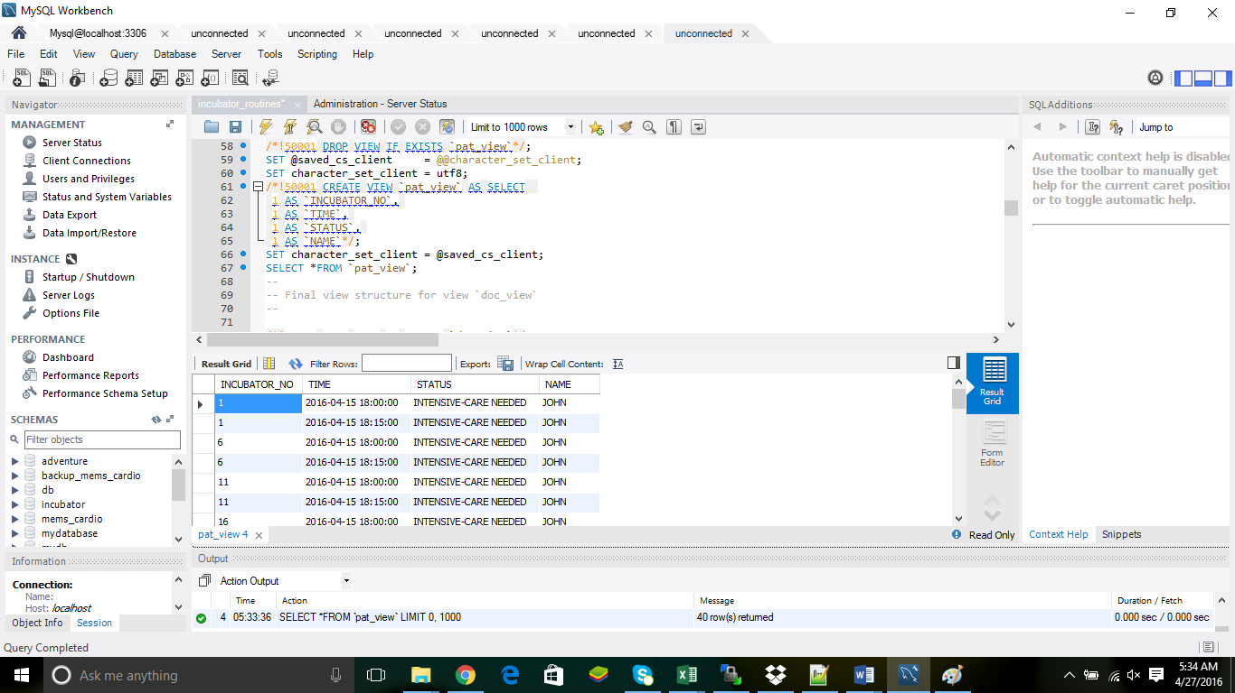
VIEWS [PATIENT]:

Slide 39
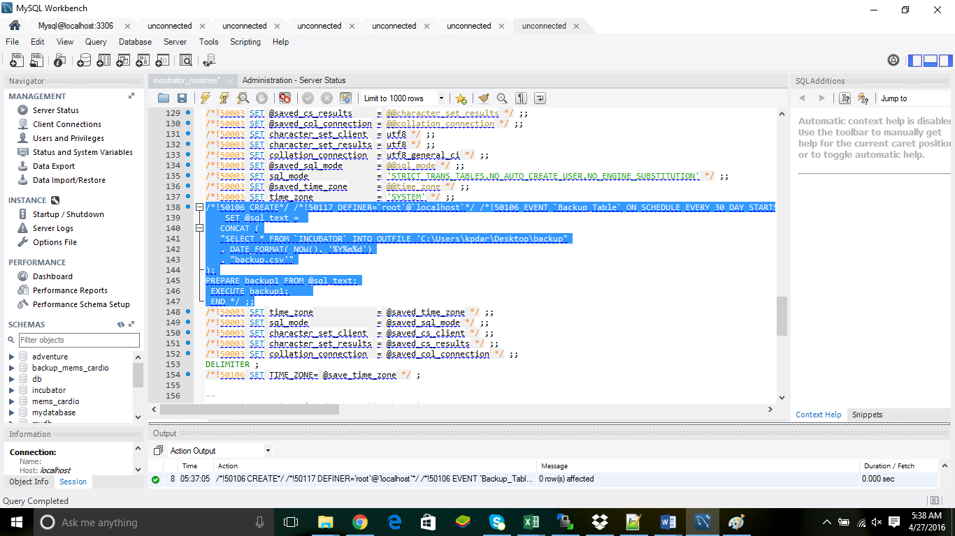
BACKUP:

Slide 40
THANK YOU

